Slide 1
Gesture Recognition

Slide 2
Problem Definition
The problem addressed is detecting the gesture of a hand in real time and do a task based on this gesture.

Slide 3
Project Motivation
The motivation behind this project is to develop a simple and computationally inexpensive approach to solve the problem.

Slide 4
Target Customers
Robotics.

Slide 5
Our Approach

Slide 6
Define an area for the hand and calculate the background.
Find the contour segmentation and locate the contour of the hand.
Use Convex Hull to draw a bounding shape for the hand.
Calculate the Center of gravity of the hand.
Find the tallest finger.
Draw a circle from the center of gravity of the hand.
Identify the names of the fingers using Convex Defects.

Slide 7
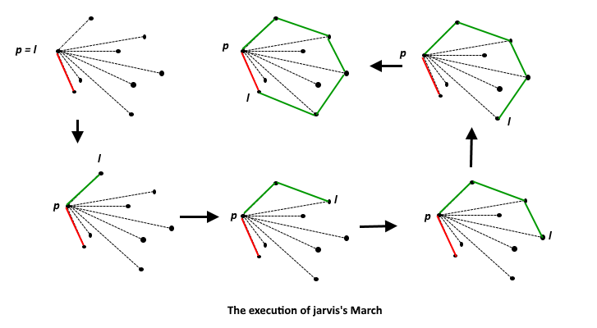
Convex Hull

Slide 8
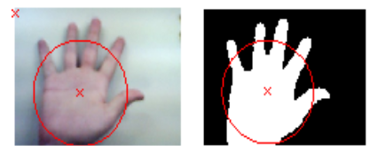
Center of Gravity and the circle

Slide 9
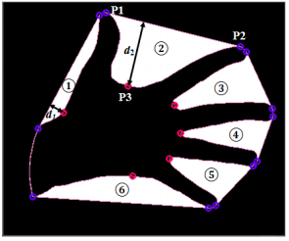
Convex Defects

Slide 10
Advantages & Disadvantages

